Slide 1


LSTM Networks for Online Cross-Network Recommendations
Dilruk Perera and Roger Zimmermann

Slide 2






Cross-network recommender systems
An effective way to alleviate the data sparsity problem in recommender systems
Items
0 | 0 | 0 | 0 | 0 | 0 | 0 | 1
1 | 0 | 0 | 0 | 0 | 0 | 0 | 0
0 | 0 | 1 | 0 | 0 | 0 | 0 | 0
0 | 0 | 0 | 0 | 0 | 1 | 0 | 0
1 | 0 | 0 | 0 | 0 | 0 | 0 | 1
Users
Interactions

Slide 3
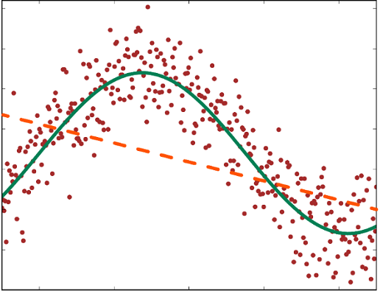
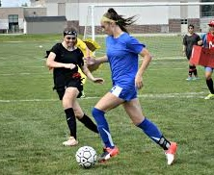








Motivation: limitations of existing solutions
Unable to capture underlying complex relationships in user data
Unable to capture dynamics in the recommender environment
$$?$$

Slide 4
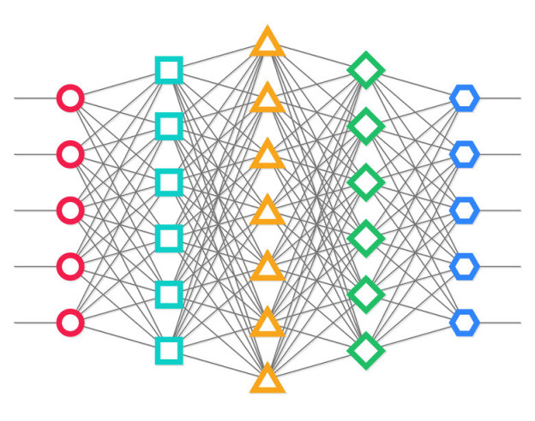
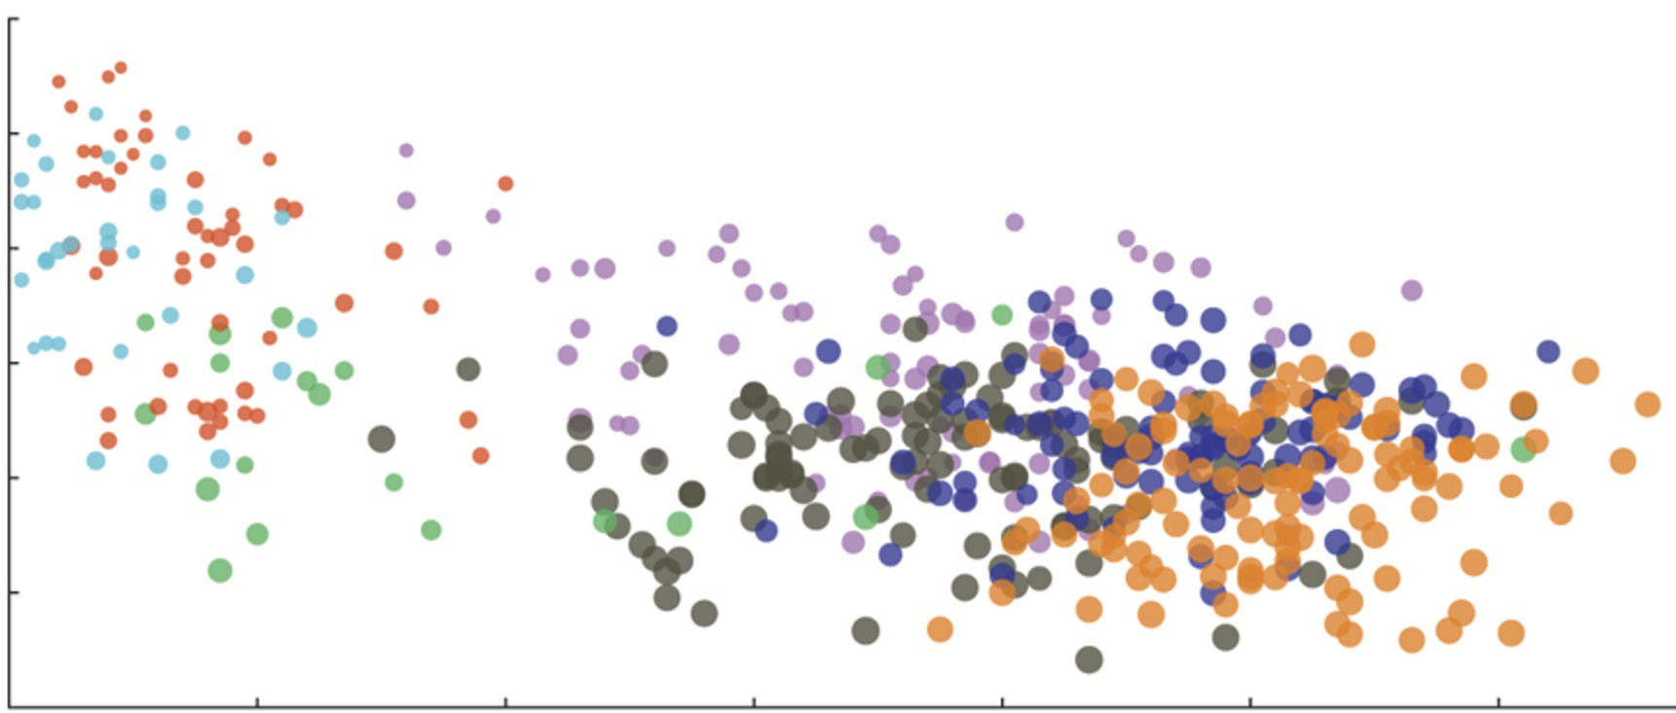
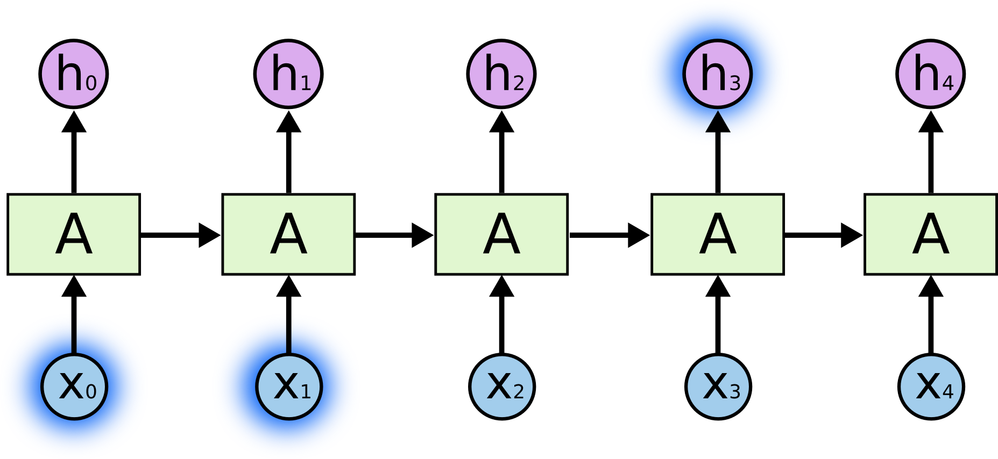






Model : LSTM
Neural architecture Online update
Limitations of LSTM in recommender setting
  Unable to handle highly sparse data
  Cell-state bottleneck
  Unable to handle irregular time gaps
$$t1$$
$$t2$$
$$t3$$
$$t4$$
$$t5$$
$$t6$$
  A higher-order interaction layer
  An attention mechanism
  Time aware gates

Slide 5
Architecture

Slide 6






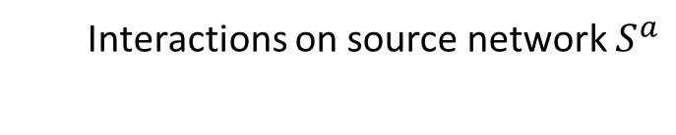
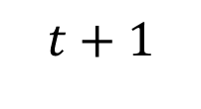
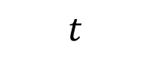
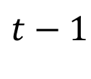
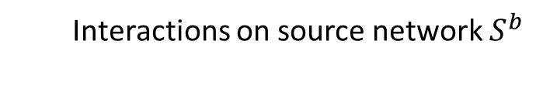
Process
$$t−1$$
$$t$$
$$t+1$$
Interactions on target network
Interactions on source network $S^{a}$
Interactions on source network $S^{b}$
User preferences on the target network
Data Heterogeneity

Slide 7
























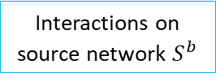







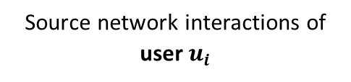

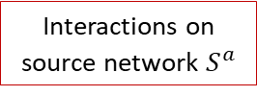













Cross-network topical layer
Source network interactions of user $u_{i}$
Cross-network topical layer
Embedding layer
Higher order interactions layer
Prediction layer
Interactions on source network $S^{a}$
$$x_{1}^{a,t}$$
$$\left(x_{1}^{a,t}∙y_{1}^{a}\right)$$
$$e_{1}^{a,t}$$
$$x_{2}^{a,t}$$
$$⋯$$
$$1$$
$$0$$
$$4$$
$$e_{1}^{a,t}$$
Target
$$⋯$$
$$x_{K^{t}}^{a,t}$$
$$\left(x_{K^{t}}^{a,t}∙y_{K^{t}}^{a}\right)$$
$$e_{K^{t}}^{a,t}$$
$$e_{K^{t}}^{a,t}$$
$$y^{t}$$
$$u_{1}$$
$$⋯$$
$$e_{1}^{a,t}. e_{K^{t}}^{a,t}$$
Training loss
$$0$$
$$1$$
Input
$$e_{K^{t}}^{a,t}.e^{i}$$
$$⋯$$
$$0$$
$$Sum$$
LSTM
cell
$$u_{i}$$
$$…$$
$$i^{∆t}$$
$${\hat{y}}^{t}$$
$$e^{i}$$
$$t−1$$
$$t$$
$$e^{i}.e_{K^{t}}^{b,t}$$
$$Pooling$$
$$u_{N}$$
$$0$$
Highly sparse
$$e_{K^{t}}^{b,t}.e_{1}$$
User vector
$$\left(x_{K^{t}}^{b,t}∙y_{K^{t}}^{b}\right)$$
$$e_{K^{t}}^{b,t}$$
$$e_{K^{t}}^{b,t}$$
$$x_{K^{t}}^{b,t}$$
$$⋯$$
$$e_{1}^{b,t}$$
$$1$$
$$0$$
Interactions on source network $S^{b}$
$$⋯$$
$$2$$
$$x_{2}^{b,t}$$
$$x_{1}^{b,t}$$
$$\left(x_{1}^{b,t}∙y_{1}^{b}\right)$$
$$e_{1}^{b,t}$$

Slide 8
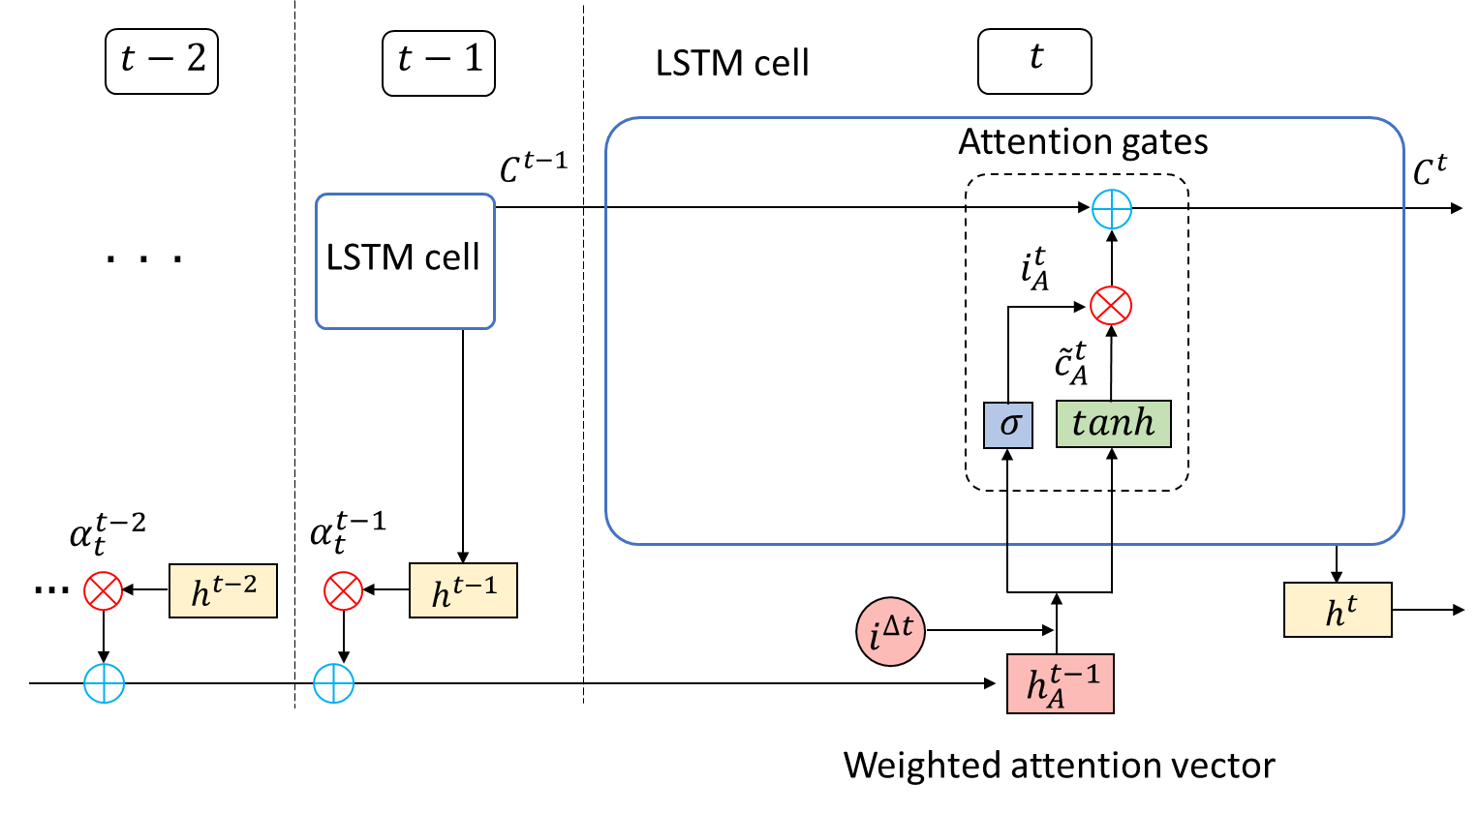
Attention gates
Allows the cell state to refer back to previous states
Reduces the burden of encoding the entire user history in the cell vector

Slide 9
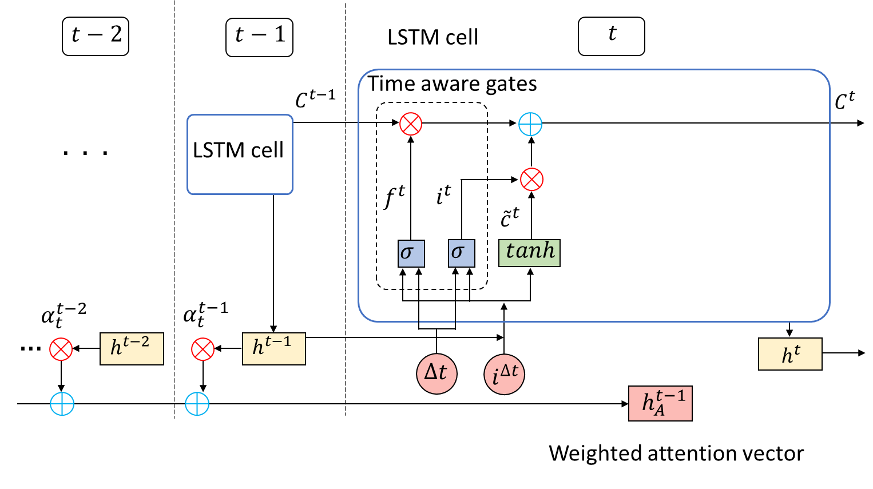
Time aware gates
When time gap increases, user preference changes tend to increase
  Previous cell state becomes less relevant
  Recent interactions on source networks could be more relevant

Slide 10
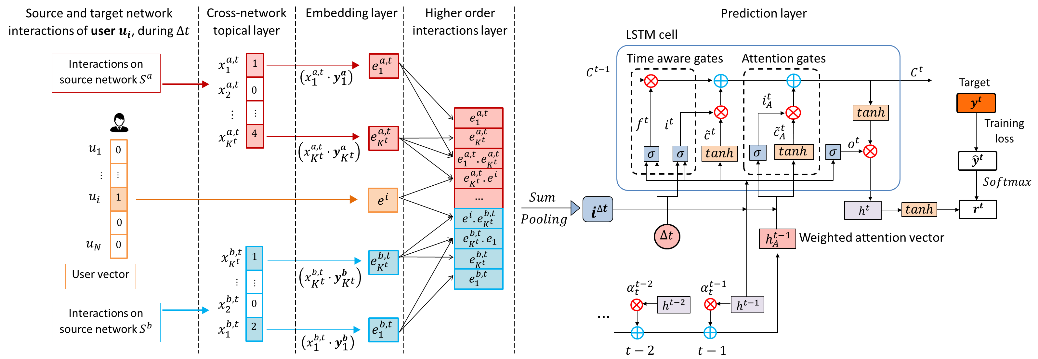
Overview

Slide 11
Experiments

Slide 12



Dataset
Target network : Source networks :
Overlapped users : 2,536 YouTube videos : 13,829
Dataset span : 1st March 2015 – 29th February 2017

Slide 13
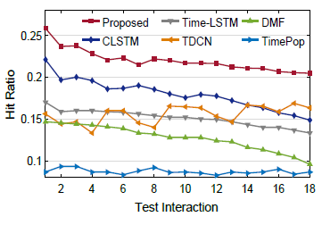
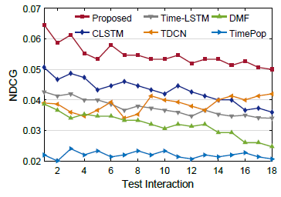
Results
Diversity: 7.7% and Novelty: 12.8% against closest baseline (CLSTM)

Slide 14
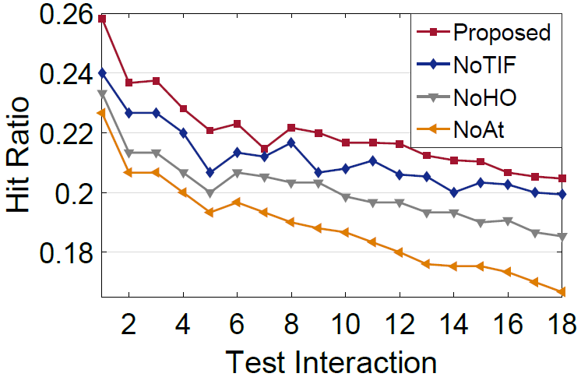
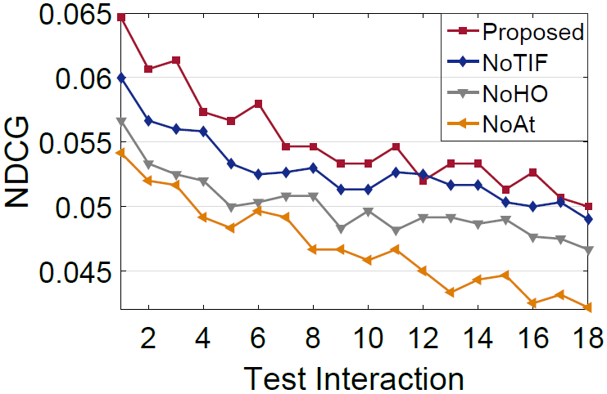
Results
NoTIF : Time aware gates are emitted
NoHO : Higher-order interaction layer is emitted
NoAt : Attention gates are emitted

Slide 15


Develop one stop recommender platforms!!
https://www.macrumors.com/how-to/apple-tv-app-store/
http://www.heightensocial.com/blog/2016/1/8/7-easy-steps-to-add-social-media-icons-to-your-gmail-signature

Slide 16

Thank You

Slide 17
Appendices

Slide 18
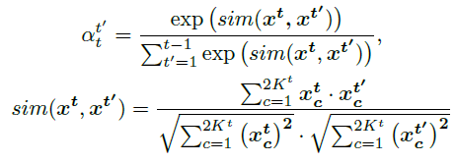
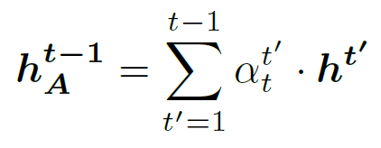
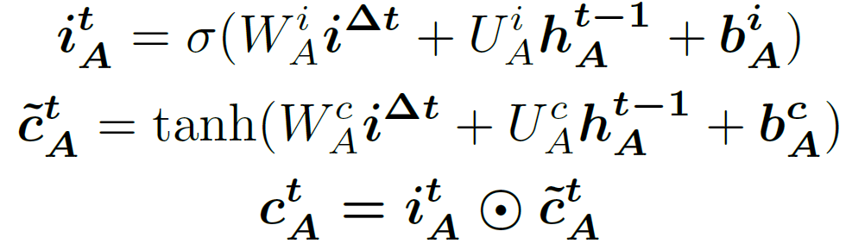
Architecture: Attention gates
Idea:

Slide 19
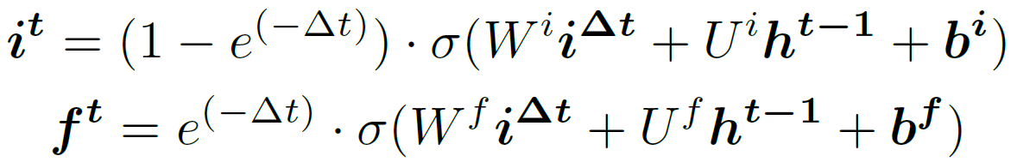
Architecture: Time aware gates
Idea:

Slide 20
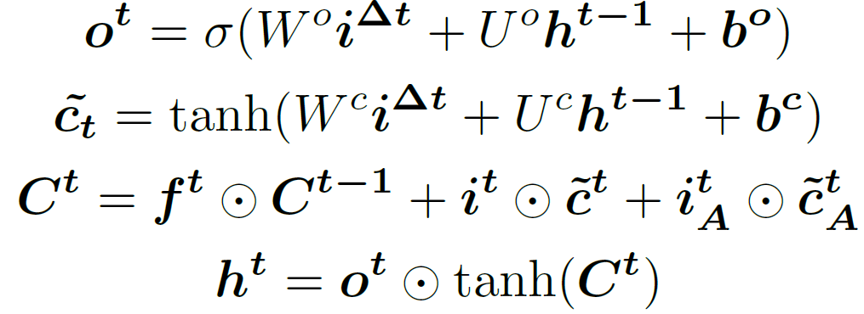
Cell gate operations

Slide 21
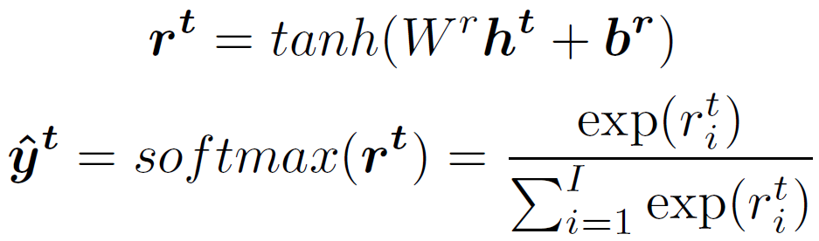
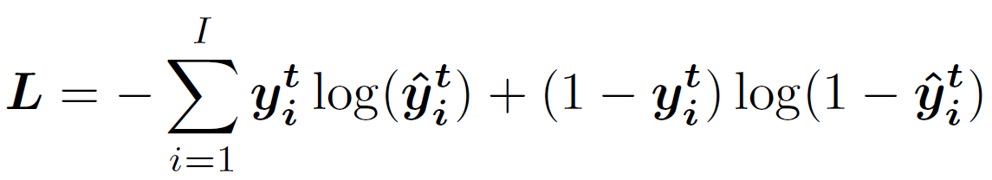
Prediction layer

Slide 22
Baselines
TimePop: Calculates the most popular item in the day to all users.
DMF: Dynamic MF [Devooght et al. 2015]
  Allows to set an explicit prior on unknown values. When new ratings, users, or items enter the system, updates the factorization in time, independent of the size of data. Hence, can quickly recommend items even to very recent users.
TDCN: Our previous work.
Time-LSTM: Uses timestamps of user interactions to capture short and long term preferences.
CLSTM : A modified version of our work, that does not include the proposed modifications.

Slide 23
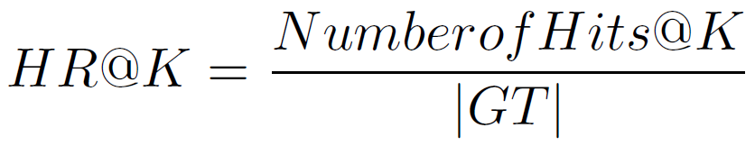
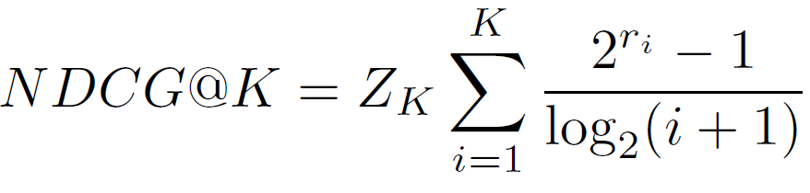
Accuracy metrics

Slide 24
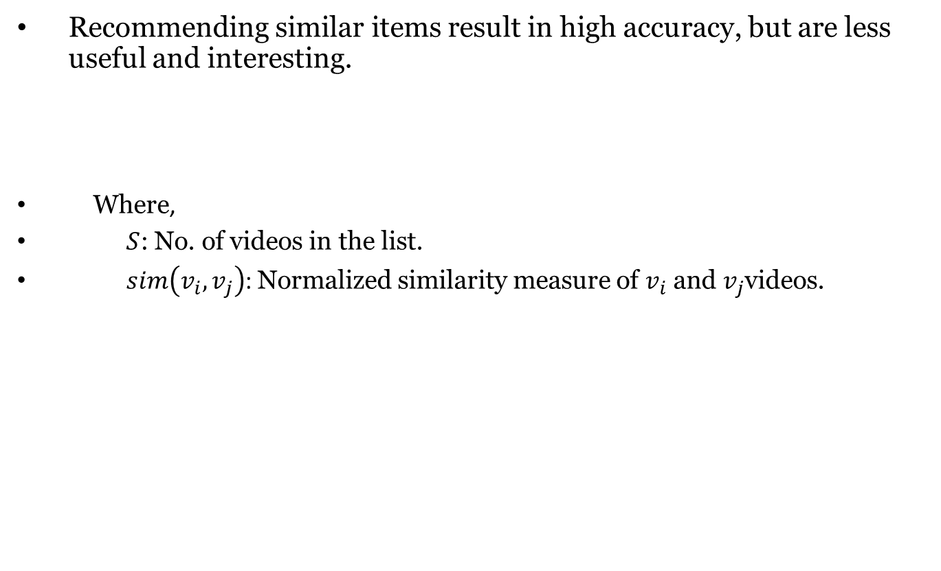
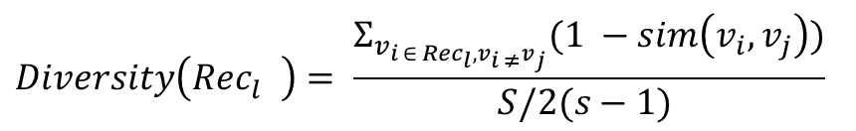
Diversity
Recommending similar items result in high accuracy, but are less useful and interesting.
Where,
      $S$: No. of videos in the list.
$sim\left(v_{i},v_{j}\right)$: Normalized similarity measure of $v_{i}$ and $v_{j}$videos.
$$Diversity\left({Rec}_{l}^{}\right)= \frac{Σ_{v_{i ∈ {Rec}_{l}, v_{i ≠}v_{j}}}(1 −sim\left(v_{i}, v_{j}\right))}{S/2(s−1) }$$

Slide 25
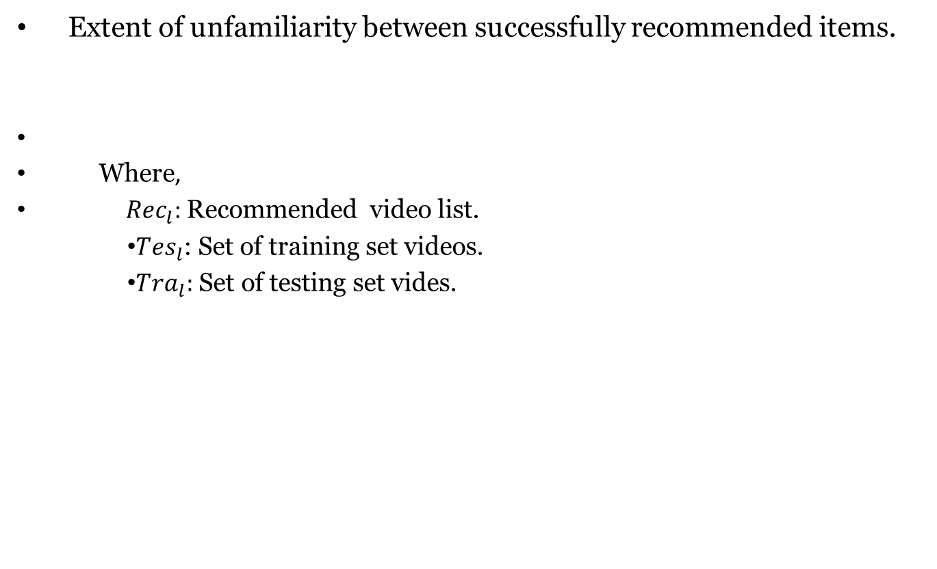
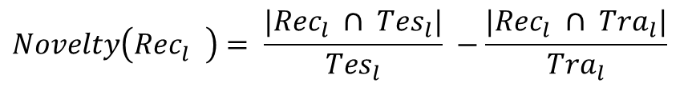
Novelty
Extent of unfamiliarity between successfully recommended items.
Where,
${Rec}_{l}$: Recommended video list.
      ${Tes}_{l}$: Set of training set videos.
      ${Tra}_{l}:$ Set of testing set vides.
$$Novelty\left({Rec}_{l}^{}\right)= \frac{|{Rec}_{l} ∩ {Tes}_{l}|}{{Tes}_{l}} −\frac{|{Rec}_{l} ∩ {Tra}_{l}|}{{Tra}_{l}}$$

